Slide 1
Go with the Flow…Leveraging Flow for Dynamic Navigation
Derek Cash-Peterson

Slide 2






Derek Cash-Peterson
Principal Architect
Professional developer since 1999
Working with SharePoint since 2006
Specialize in branding/UX development
https://spdcp.com
linkedin.com/in/derek-cash-peterson-6320752
@spdcp
https://github.com/dcashpeterson/Public-Samples
Notes:
How many citizen developers?
How Many developers?

Slide 3
Agenda
Current Options for Navigation
Why Build Your Own?
Create Custom Header/Footer
Connect it to Power Automate (aka Flow)
Q&A

Slide 4
Standard Navigation Update Process
Need Change to Navigation
Call Developer or Open Support Ticket
Wait for developer to have time
Developer makes change
Review Change
Iterate on change
Approve Change
Wait for Change Window
Launch Change

Slide 5
Agenda
Current Options for Navigation
Why Build Your Own?
Create Custom Header/Footer
Connect it to Power Automate (aka Flow)
Q&A

Slide 6

Current Options for Navigation
Hub Site Header
Site Navigation
Site Footer
Quick Launch

Slide 7
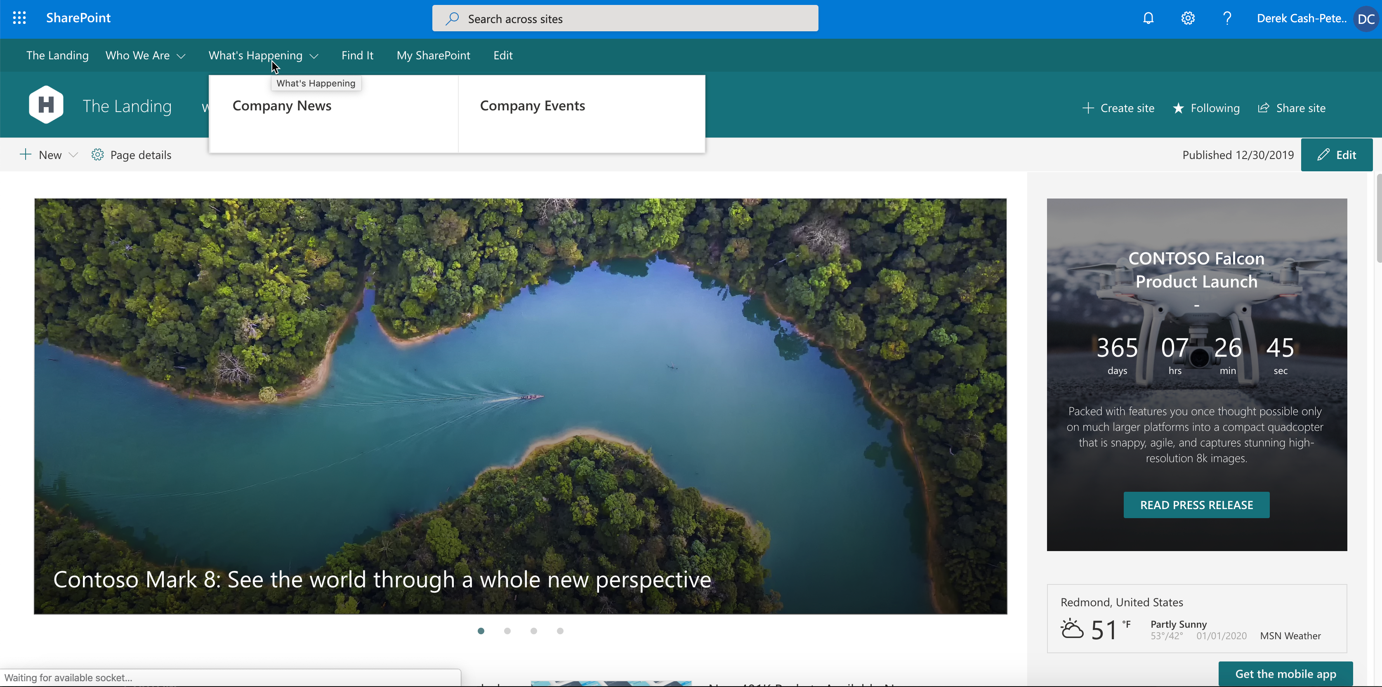
Hub Site Header

Slide 8
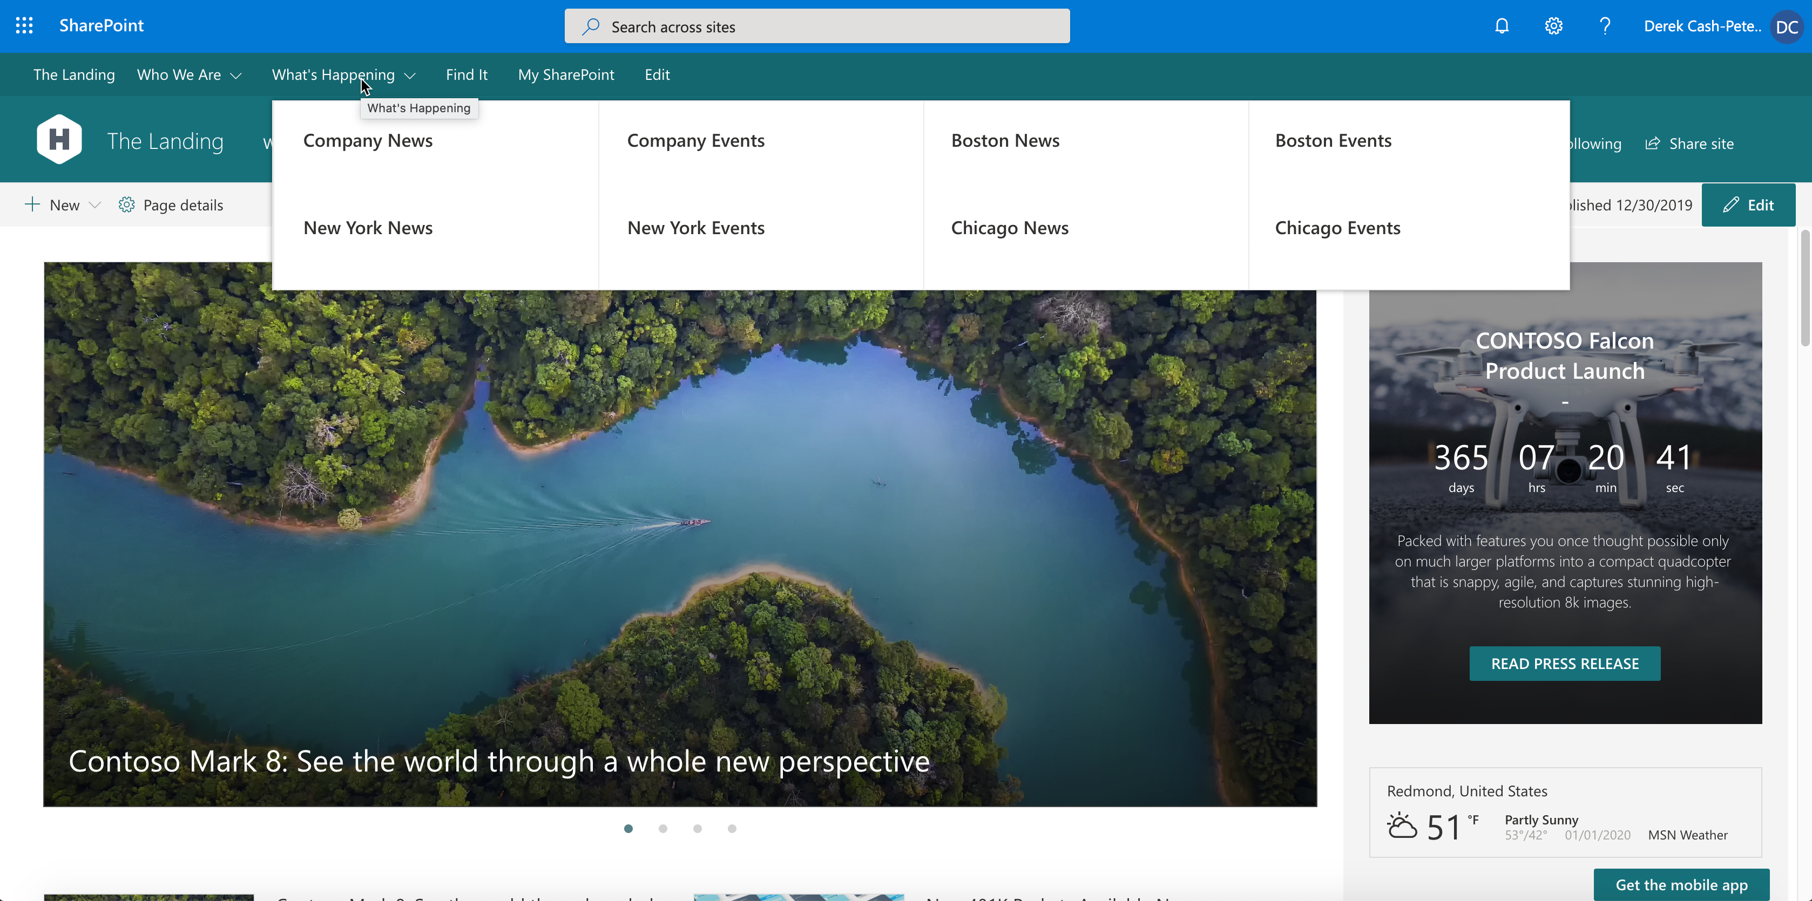
Hub Site Header

Slide 9
Hub Site Header
Pros

Slide 10
Hub Site Header
Pros
Easy to use

Slide 11
Hub Site Header
Pros
Easy to use
Multi-level

Slide 12
Hub Site Header
Pros
Easy to use
Multi-level
Allows for manual edits

Slide 13
Hub Site Header
Pros
Easy to use
Multi-level
Allows for manual edits
Mega-menu capabilities

Slide 14
Hub Site Header
Pros
Easy to use
Multi-level
Allows for manual edits
Mega-menu capabilities
Responsive

Slide 15
Hub Site Header
Pros
Easy to use
Multi-level
Allows for manual edits
Mega-menu capabilities
Responsive
Excellent for a single hub experience

Slide 16
Hub Site Header
Cons

Slide 17
Hub Site Header
Cons
Takes up a lot of real-estate

Slide 18
Hub Site Header
Cons
Takes up a lot of real-estate
Limited to 3 levels

Slide 19
Hub Site Header
Cons
Takes up a lot of real-estate
Limited to 3 levels
Quickly gets overloaded

Slide 20
Hub Site Header
Cons
Takes up a lot of real-estate
Limited to 3 levels
Quickly gets overloaded
Limited to single hub

Slide 21
Hub Site Header
Cons
Takes up a lot of real-estate
Limited to 3 levels
Quickly gets overloaded
Limited to single hub
Not global

Slide 22
Hub Site Header
Cons
Takes up a lot of real-estate
Limited to 3 levels
Quickly gets overloaded
Limited to single hub
Not global
No control over fonts and colors

Slide 23
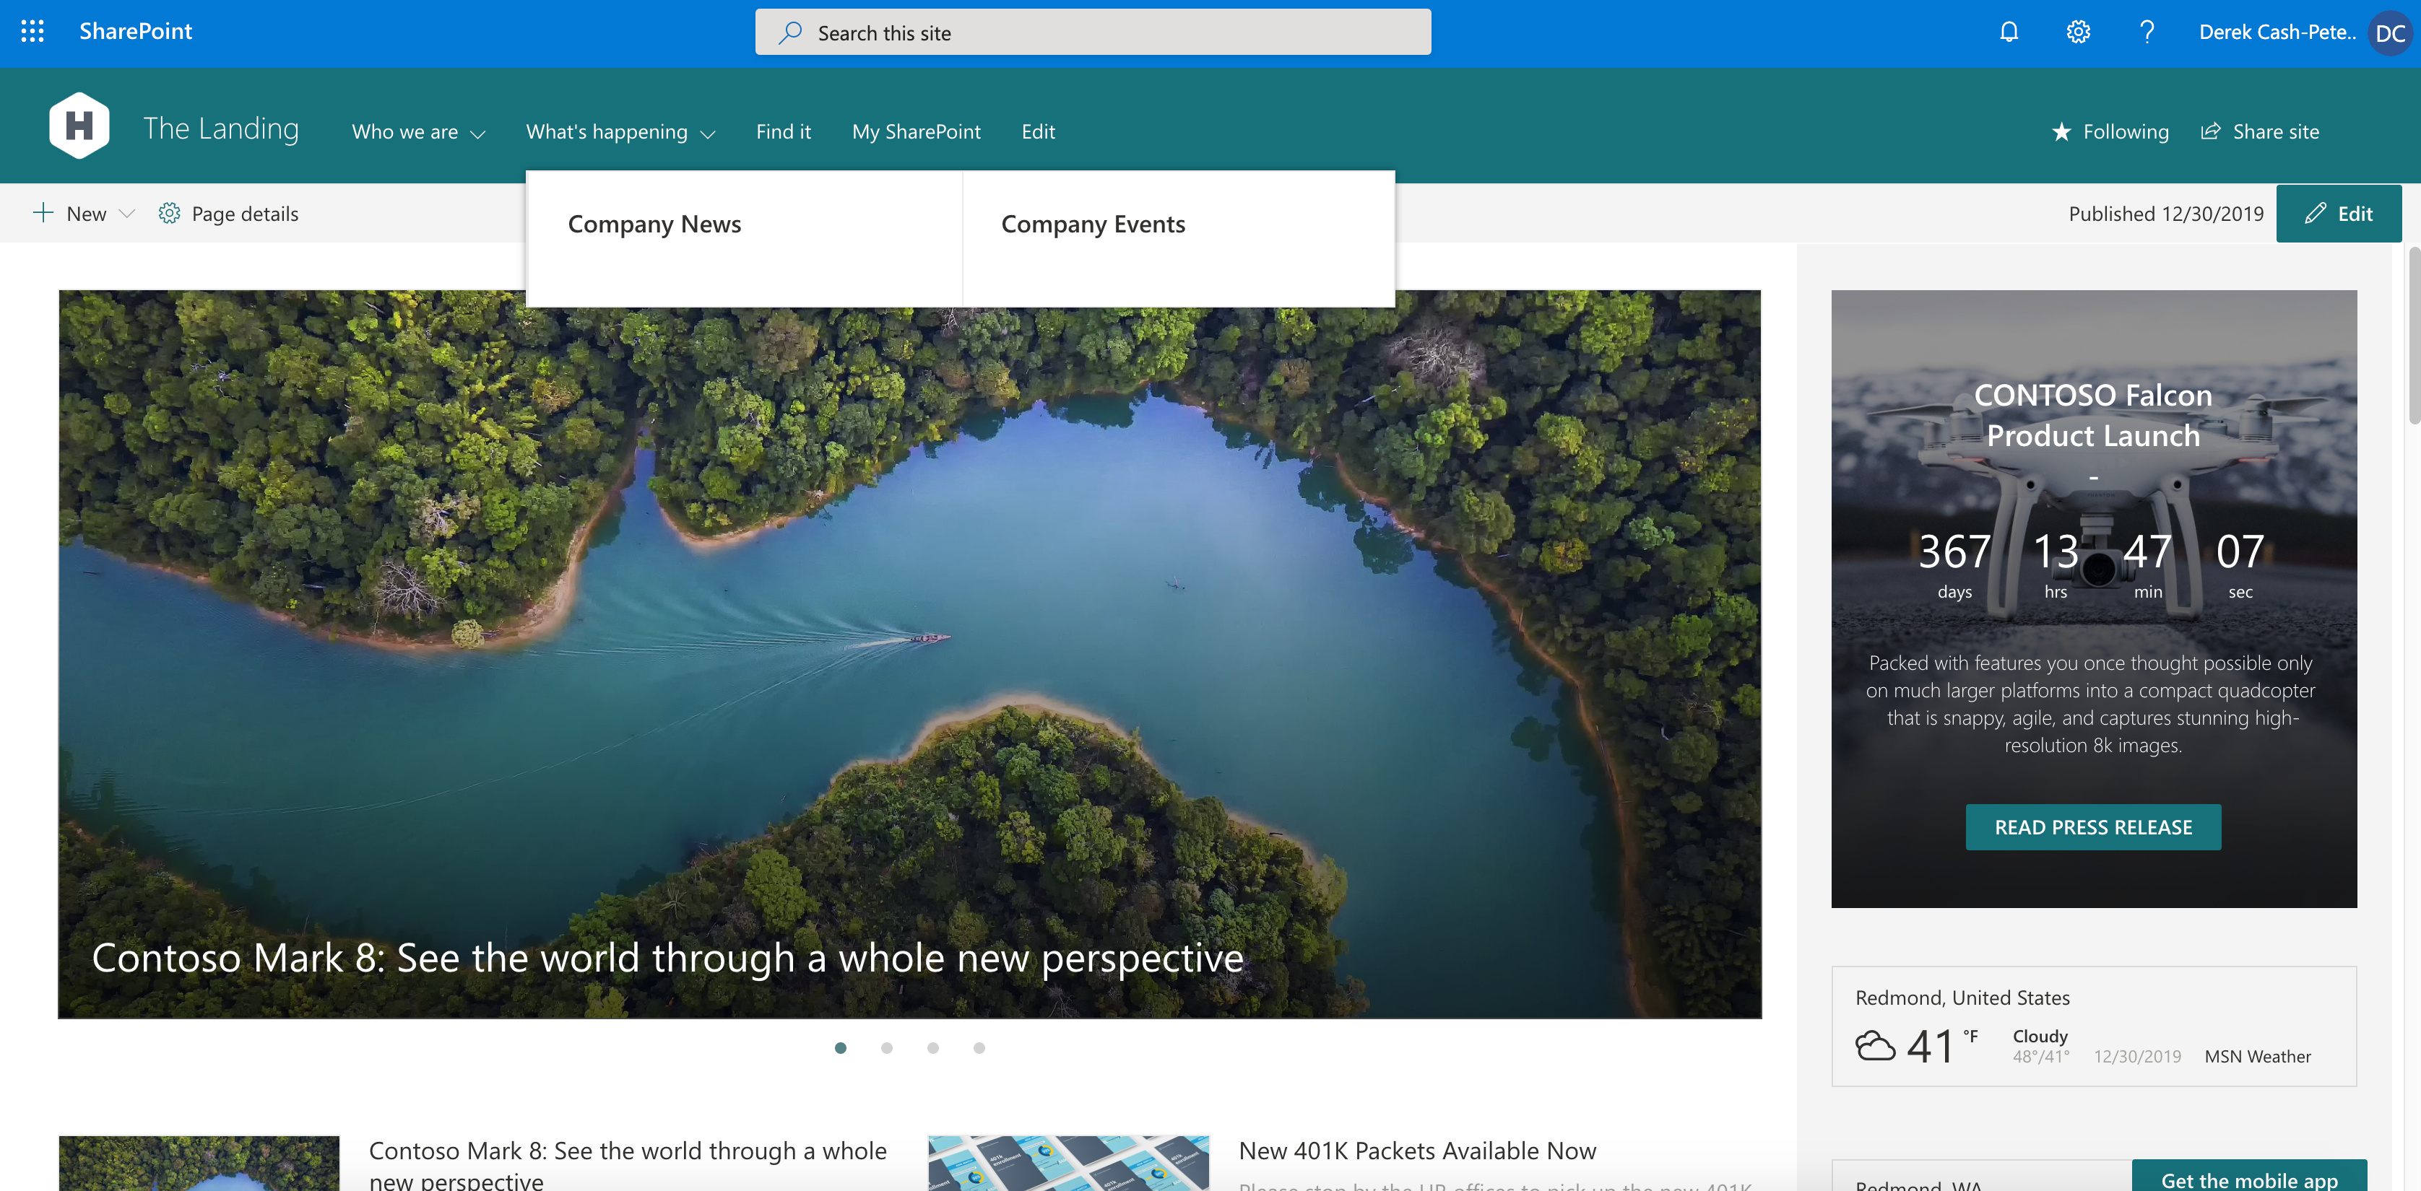
Site Navigation

Slide 24
Site Navigation
Pros

Slide 25
Site Navigation
Pros
Easy to use
Multi-level
Allows for manual edits
Mega-menu capabilities
Responsive

Slide 26
Site Navigation
Pros
Easy to use
Multi-level
Allows for manual edits
Mega-menu capabilities
Responsive
Perfect for in-site navigation

Slide 27
Site Navigation
Cons

Slide 28
Site Navigation
Cons
Takes up a lot of real-estate
Limited to 3 levels
Quickly gets overloaded
Not global
No control over fonts and colors

Slide 29
Site Navigation
Cons
Takes up a lot of real-estate
Limited to 3 levels
Quickly gets overloaded
Not global
No control over fonts and colors
Limited to the current site

Slide 30

Site Footer

Slide 31
Site Footer
Pros

Slide 32
Site Footer
Pros
Easy to use
Allows for manual edits
Responsive

Slide 33
Site Footer
Pros
Easy to use
Allows for manual edits
Responsive
Easy way to show links in a complex site

Slide 34
Site Footer
Cons

Slide 35
Site Footer
Cons
Single Level

Slide 36
Site Footer
Cons
Single Level
No Headers

Slide 37
Site Footer
Cons
Single Level
No Headers
Limited to a single site

Slide 38
Site Footer
Cons
Single Level
No Headers
Limited to a single site
Not global

Slide 39
Site Footer
Cons
Single Level
No Headers
Limited to a single site
Not global
Needs to be recreated to be consistent

Slide 40
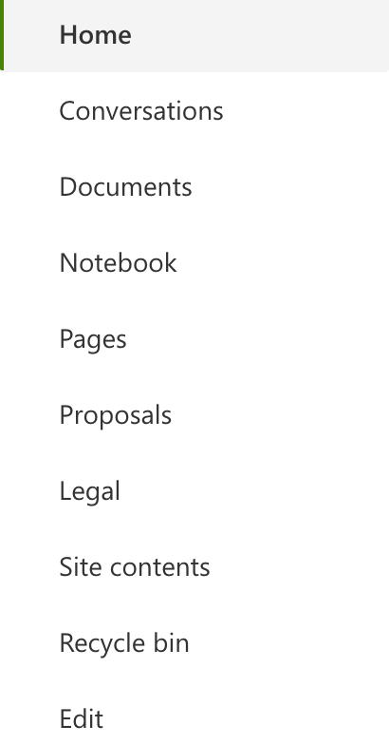
Quick Launch

Slide 41
Quick Launch
Pros

Slide 42
Quick Launch
Pros
Easy to use
Multi-level
Allows for manual edits

Slide 43
Quick Launch
Pros
Easy to use
Multi-level
Allows for manual edits
Perfect for team or collaboration sites

Slide 44
Quick Launch
Cons

Slide 45
Quick Launch
Cons
Limited to 3 levels
Not global
No control over fonts and colors

Slide 46
Quick Launch
Cons
Limited to 3 levels
Not global
No control over fonts and colors
Only available on Team Sites

Slide 47
Agenda
Current Options for Navigation
Why Build Your Own?
Create Custom Header/Footer
Connect it to Power Automate (aka Flow)
Q&A

Slide 48

Why build your own*?

Slide 49
Why build your own*?
Needs to be on every site regardless of hub association

Slide 50
Why build your own*?
Needs to be on every site regardless of hub association
Need a custom user interface

Slide 51
Why build your own*?
Needs to be on every site regardless of hub association
Need a custom user interface
Needs to work on classic and modern

Slide 52
Why build your own*?
Needs to be on every site regardless of hub association
Need a custom user interface
Needs to work on classic and modern
Need custom functionality not currently part of the navigation
Audience targeting-Q2 2020
Need navigation on mobile

Slide 53
Why build your own*?
Needs to be on every site regardless of hub association
Need a custom user interface
Needs to work on classic and modern
Need custom functionality not currently part of the navigation
Audience targeting-Q2 2020
Need navigation on mobile
*Custom Code is not always the answer! Think OOTB first!

Slide 54
Agenda
Current Options for Navigation
Why Build Your Own?
Create Custom Header/Footer
Connect it to Power Automate (aka Flow)
Q&A

Slide 55

Let’s Get Started

Slide 56
Demo

Slide 57
Agenda
Current Options for Navigation
Why Build Your Own?
Create Custom Header/Footer
Connect it to Power Automate (aka Flow)
Q&A

Slide 58
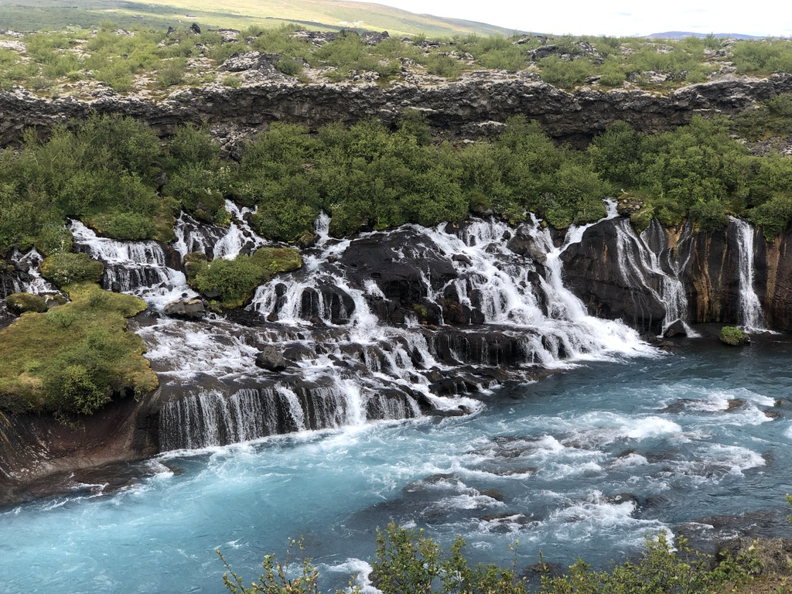
Go with the Flow Tips

Slide 59
Go with the Flow Tips
Flows run as the user that created them

Slide 60
Go with the Flow Tips
Flows run as the user that created them
Create a service account

Slide 61
Go with the Flow
Flows run as the user that created them
Create a service account
Take an encapsulated approach to development

Slide 62
Go with the Flow
Flows run as the user that created them
Create a service account
Take an encapsulated approach to development
Name your flows well and consistently

Slide 63
Power Automate Architecture
L1 On Delete
L1 On Create or Modify
L2 On Create or Modify
L2 On Delete
HTTP Trigger
List Triggers
Logic that reads list and generates the JSON

Slide 64
Power Automate Architecture
L1 On Delete
L1 On Create or Modify
L2 On Create or Modify
L2 On Delete
HTTP Trigger
List Triggers
Logic that reads list and generates the JSON

Slide 65
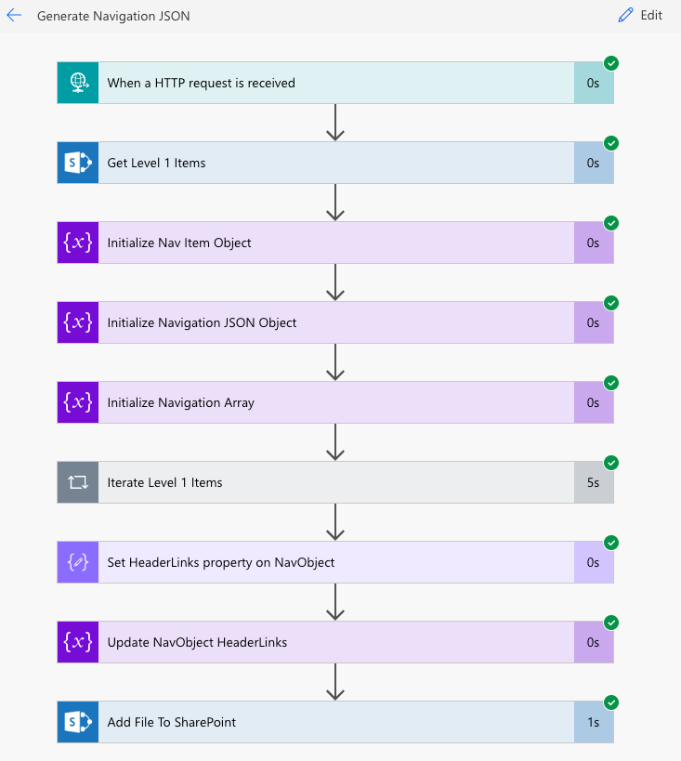
HTTP Trigger

Slide 66
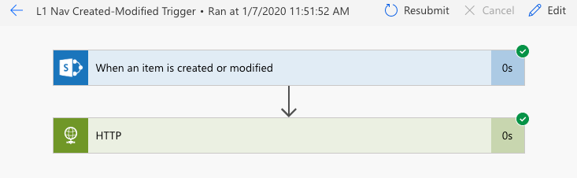
List Trigger

Slide 67
Demo

Slide 68
Standard Navigation Update Process
Need Change to Navigation
Call Developer or Open Support Ticket
Wait for developer to have time
Developer makes change
Review Change
Iterate on change
Approve Change
Wait for Change Window
Launch Change

Slide 69
New Navigation Update Process
Need Change to Navigation
Make Navigation Change
Wait for Flow to Run
Launch Change

Slide 70
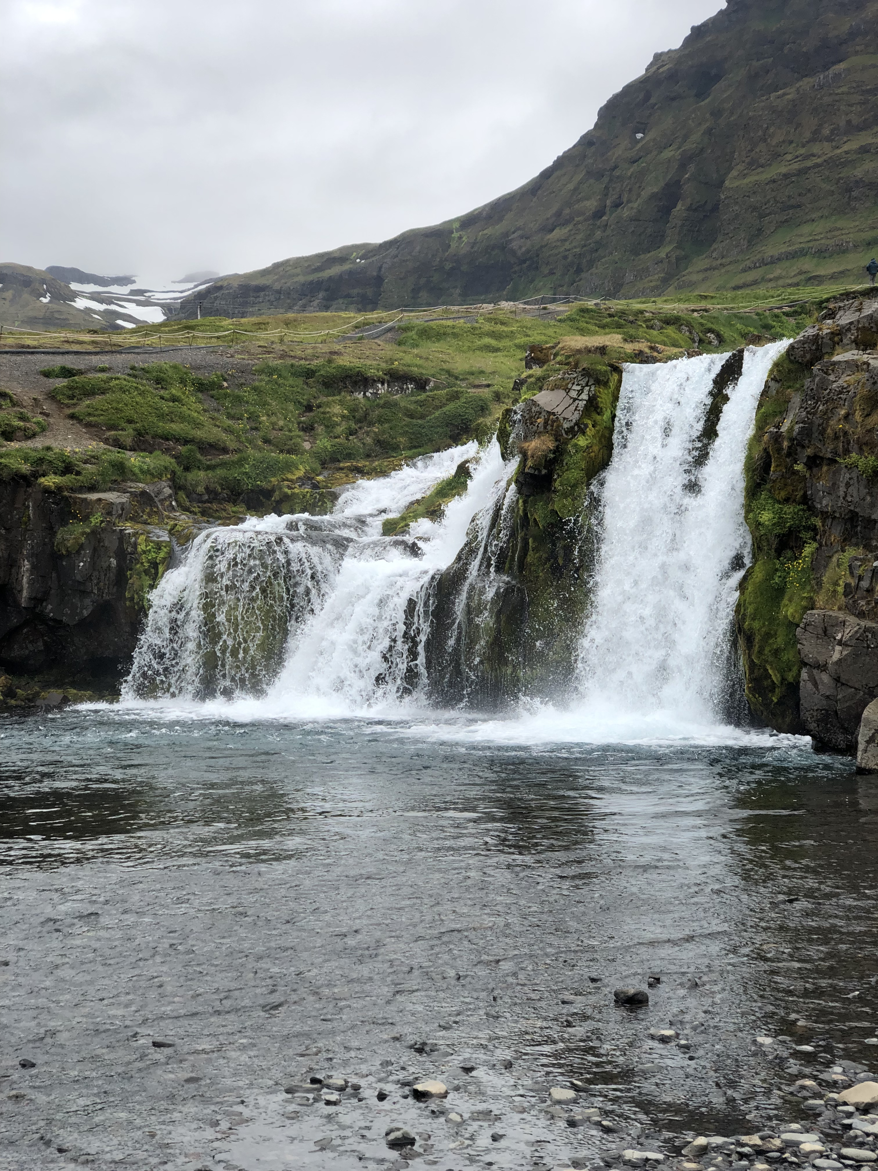
Recap

Slide 71
Recap
Reviewed the different types of navigation options in Modern SharePoint

Slide 72
Recap
Reviewed the different types of navigation options in Modern SharePoint
Reviewed reasons for a custom navigation component

Slide 73
Recap
Reviewed the different types of navigation options in Modern SharePoint
Reviewed reasons for a custom navigation component
Built a custom navigation component attached to static JSON file

Slide 74
Recap
Reviewed the different types of navigation options in Modern SharePoint
Reviewed reasons for a custom navigation component
Built a custom navigation component attached to static JSON file
Created Flows that got list data and generated JSON replacing static JSON file

Slide 75
Time for Q&A…

Slide 76
Resources
PnP SPFX Generator https://pnp.github.io/generator-spfx/
SPFX-dev-extensions https://github.com/SharePoint/sp-dev-fx-extensions/tree/master/samples/react-menu-footer-classic-modern Julie Turner, App Customizer Post https://julieturner.net/2019/09/sharepoint-framework-application-customizer-cross-site-page-loading/
The Code https://github.com/dcashpeterson/Public-Samples

Slide 77
THANK YOU!

